Slide 1

Cloud Service Center Dashboard- 10/6/2020
Projects
Hours & Forecast
Migration
3
Upcoming
3
See next slide for details
BassPro is ramping up, and looks like it will be extended until mid-end of September
Elekta will likely have to be reduced in a week or two until migrations get started
Providence should start ramping up in the next week or two as applications are discovered and planned
Elekta
Providence
Hussmann
Panasonic (LZ, Mig)
CU Direct
Univ of Wisconsin (LZ)
Landing Zone
3
Rolling Off / On Hold
2
Substantial
CDW
Stone Brewing
Bass Pro
Flow Intl
Stats
 | 2 weeks ago | Last Week | This Week | Next Week | 2 weeks out | 3 weeks out
Projects | 7 | 7 | 6 | 6 | 8 | 7
Mig VMs | 112 | 37 | 2 | N/P | N/P | N/P
Mig DBs | 0 | 0 | 0 | N/P | N/P | N/P
Other Work | 0 | 0 | 0 | N/P | N/P | N/P
2
Resources Scheduled
To Migrate
This week so far
Support
-
0
Updates / New Items
Blockers / Challenges
Improvement Items
Service Expansion
  In-Progress:
  Azure VMware Solution
  SQL Server/DB Migration Enhancements
  Managed Services Transition
  ALZ Engineering/Deployment
  WVD Quickstart Deployments
Hussmann – major pushback from the app owners on their end.
Migration automation
  Full end to end automation
  Additional post-migration operations setup automation
  Getting the team to actually use the automation!
WVD deployment process documentation, scripts, automation, training
LZ deployment and code improvements – more standardized approach, easier deployment methods.

Slide 2
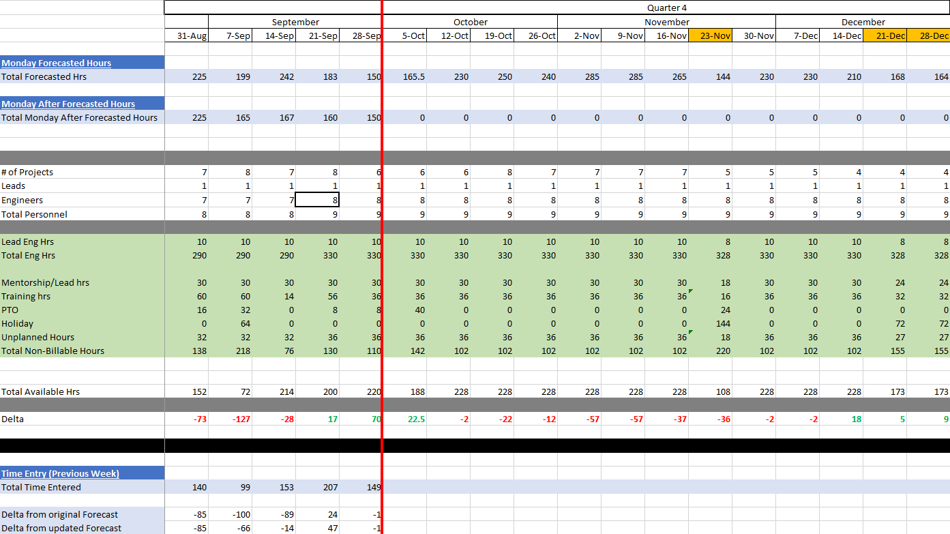

Slide 3
Cloud Service Center Metrics
CMC Utilization %
Forecast
Total Migrated Resources
CMC Utilization %
Actual Billed
Work Items by Client

